Slide 1
Using Terminology in HL7 FHIR
Reuben Daniels, FAIDH CHIA
HL7 Working Group Meeting Plus
New Orleans, Louisiana, USA

Slide 2
About this presentation
This presentation
can be downloaded here:
Actual link: https://github.com/FHIR/documents/tree/master/presentations/2023-05%20Tutorials
Short link: https://bit.ly/3nGwkwQ
is licensed for use under the Creative Commons, specifically:
Creative Commons Attribution 3.0 Unported (CC BY 3.0)
TL;DR: Do with it as you wish – just give credit.
is based on Release 4B (v4.3.0) version of HL7 FHIR as published here http://hl7.org/fhir/R4B/
Relevant and significant changes introduced in the FHIR R5 will be highlighted during the tutorial including changes to the ConceptMap resource.

Slide 3

About me
Reuben Daniels FAIDH CHIA (he/him) | reuben@saludax.com
Principal Consultant with Saludax based in Brisbane, Australia
24 years of professional ICT experience, 14 in Healthcare ICT / eHealth / Digital Health
Former lead architect in the Australian federal government
Led the design of two of Australia’s FHIR-based terminology service solutions including the National Clinical Terminology Service (NCTS) — https://www.healthterminologies.gov.au
HL7 International
Member and standards developer since 2010
Co-chair of the Terminology Infrastructure (formerly Vocabulary) Work Group (WG)
Co-chair of the Terminology Services Management Group (TSMG)
Contributor to HL7 Terminology (THO) and the Unified Terminology Governance (UTG) process
HL7 Australia Affiliate Board Director
Founding Fellow of the Australasian Institute of Digital Health (AIDH) and the FHIR Foundation

Slide 4
About you
Introduce yourself and answer any of the following questions
What is your background and role (e.g., technical, clinical, management, etc) ?
Are you familiar with code systems and terminologies (e.g., SNOMED CT, LOINC) ?
How familiar are you with FHIR?
Are you familiar with any other information model standards (e.g., V2, CDA, etc.)?
Have you or are you currently developing a solution (or technical specification) which may benefit from the use of FHIR?
Have you taken other HL7 Vocabulary training / tutorials?
Do you have any initial questions, comments, or topics to cover?

Slide 5
Content
This tutorial will cover the following areas
Terminology basics
FHIR Terminology module introduction
Coded data types
Terminology resource types
Terminology operations
Terminology documentation
The FHIR Terminology Service
Additional topics (if time allows)
Introduction to HL7 Terminology (THO) product and the Unified Terminology Governance (UTG) process
Terminology groups in HL7
Links to further reading

Slide 6
Credit
In addition to the FHIR specification, this tutorial relies on information in the following HL7 publications
HL7 Specification: Characteristics of a Value Set Definition, Release 1 (2019) http://www.hl7.org/documentcenter/private/standards/HL7_SPEC_VSD_R1_2019MAR.pdf
HL7 Version 3 Standard: Core Principles and Properties of HL7 Version 3 Models, Release 1 (2012) https://www.hl7.org/documentcenter/public/standards/V3/core_principles/infrastructure/coreprinciples/v3modelcoreprinciples.html#coreP_Coded_Properties-concepts

Slide 7
terminology Basics

Slide 8
Terminology basics 1/6
Concepts
A concept is a unitary mental representation of a real or abstract thing – an atomic unit of thought e.g., femur, Has or had COVID-19, aspirin, Australia, English, etc.
A concept representation is a vocabulary object that enables the manipulation of a concept. For example, in information exchange based on HL7 specifications.
A code is a concept representation published by the author of a code system as part of the code system. It is the preferred unique identifier for that concept in that code system for the purpose of communication and is used in the code property of an HL7 coded data type e.g., 71341001 (SNOMED CT™), 99349-3 (LOINC™), 1191 (RxNorm), AU (ISO 3166), en (IETF BCP 47 language tag)
A designation (or description) is a concept representation that may be published by the code system author and is a human language symbol for a concept that is intended to convey the concept’s meaning to a human being.

Slide 9
Terminology basics 2/6
Code systems
The context in which a concept is defined is called a code system.
A code system is a collection of uniquely identifiable concepts with associated representations, designations, associations and meanings, published by a single organization or authority.
Many code systems exist in the clinical domain, such as ICD-10™, SNOMED CT, and LOINC, in addition to code systems defined by HL7.
In addition to concept definitions, a code system may include or support properties for concepts, relationships between concepts, filters, mechanisms for implementing hierarchies, support for multiple languages, versions, grouping of concepts, and the capability for the composition of new concepts using a syntax or grammar.

Slide 10
Terminology basics 3/6
Code system supplements
A code system supplement is a technical artifact which can extend an existing code system through the addition of new designations and / or properties to the code system’s existing concepts.
Code system supplements can not
change or remove content in the code system
add new concepts
Code system supplements may be defined by parties other than the code system’s owner / authority.
Supplements are generally used to address the following use cases:
adding support for additional human languages to a code system
adding additional properties to the code system’s concepts e.g., adding properties to concepts to support the user interface functionality.

Slide 11
Terminology basics 4/6
Value sets
A value set describes a collection of concepts drawn from one or more code systems grouped together for a specific purpose e.g., adverse reaction agent codes from SNOMED CT appropriate for an electronic health record (EHR) system.
A concept in a value set may be a single concept or a post-coordinated expression.
Value sets may select codes from multiple code systems and even multiple versions of the same code system.
Key use cases for value sets include:
specifying a set of codes drawn from one or more code systems, intended for use in a particular context.
to link code system definitions and their use in coded elements.

Slide 12
Terminology basics 5/6
Value set expansions
Expanding a value set is the process of determining the collection of codes and their descriptions suitable for data entry or validation based on the definition of a value set.
The collection of codes produced by this process is known as a value set expansion.
Value set expansions are usually (but not always) generated by specialized software e.g., a terminology server which can evaluate the value set definition and understand its underpinning code systems.

Slide 13
Terminology basics 6/6
References to “value set”
In the absence of an explicit context, the phrase “value set” is usually taken to mean BOTH of the following:
A Value Set Definition which is a description of the set of concept representations (usually codes) that are intended for use; and
A Value Set Expansion which is the set of resulting codes from a value set expansion drawn from one or more specific code systems.

Slide 14
terminology module Introduction

Slide 15
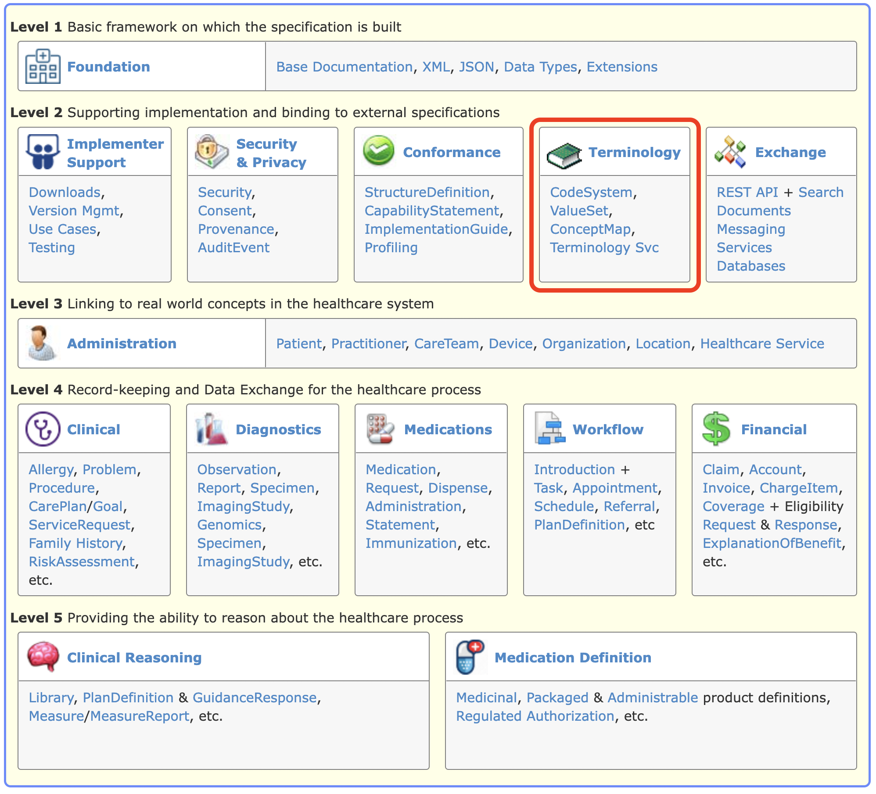
Terminology module introduction 1/2
The Terminology module in FHIR
The content of the FHIR platform specification is organized as a set of modules each with a level from 1-5.
Lower levels deal with more infrastructural concerns while higher levels deal with content and reasoning.
The level 2 modules support implementation and binding to external specifications.
The Terminology module (highlighted) is a level 2 module

Slide 16
Terminology module introduction 2/2
The Terminology module
is published here: http://hl7.org/fhir/R4B/terminology-module.html
relies on components of the Foundation, Exchange and Conformance modules
brings together the capabilities that are used for representing and communicating coded, structured data in the FHIR core specification and profiles
is composed of the following capabilities
Coded data types
Resources
Operations
Documentation
The FHIR Terminology Service

Slide 17
CODED Data types

Slide 18
Coded data types 1/4
Coded data types
are defined as part of the Data Types component of the Foundation module.
are curated by the FHIR Infrastructure Work Group in HL7.
include the following data types
code
Coding
CodeableConcept

Slide 19

Coded data types 2/4
The code data type
is simply a string representing the code for a concept.
the data type does not include identification of the code system nor the display name (description) of the associated concept because these are fixed elsewhere (e.g., in the specification which defines the data element)
is commonly used for structural data elements where the set of appropriate values are fixed and rarely change e.g., status values such as draft, active, retired and unknown.
is considered essential to interoperability.

Slide 20

Coded data types 3/4
The Coding data type
supports representation of the concept’s code and the following additional attributes:
the code system
the code system version
the concept’s display name (description)
whether (or not) the concept was directly selected by a user
Coding data elements are generally not used directly because an instance can only represent a single concept from a single code system. Interoperability often requires multiple concepts from different code systems i.e., translations.

Slide 21

Coded data types 4/4
The CodeableConcept data type
is a data type consisting of zero or more Coding elements representing the same concept. The coding elements may have slightly different granularity due to the differences in the definitions of the underlying codes.
supports the typical interoperability use case of sending a local code that a concept was coded with, and additionally one or more translations to other (often publicly defined) code systems such as LOINC or SNOMED CT.
has a text element for representation of the concept as entered or chosen by the user.

Slide 22
Terminology Resources types

Slide 23
Terminology resource types 1/9
Terminology resource types
include the following resources types
CodeSystem (Normative)
ValueSet (Normative)
ConceptMap (FMM 1)
NamingSystem (FMM 2)
TerminologyCapabilities (FMM 1)
have common metadata data elements
a status and experimental indicator
a human-readable title (except NamingSystem) and a machine-processible name
identifiers, version, status, publication date
description, purpose and publisher
contacts

Slide 24
Terminology resource types 2/9
The CodeSystem resource type
is used to declare the existence of and describe a code system or code system supplement and its key properties; and optionally define some or all its concepts.
has data elements to represent various parts of a code system including
copyright
case sensitivity
the meaning of a hierarchy (if one exists)
whether the CodeSystem resource represents a complete code system (with concepts), a supplement, a fragment, code system metadata only, or an example code system
whether a compositional grammar is defined
filters for selecting parts of the code system’s concept e.g., in value sets
code system defined concept properties
concepts together with their definitions, display names an alternative designations

Slide 25
Terminology resource types 3/9
The CodeSystem resource type
may list some or all the concepts in the code system, along with their basic properties (code, definition, display name), additional designations, and additional properties.
is not intended
to support the process of maintaining a code system.
for distributing the entirety of large existing code systems like SNOMED CT, LOINC, RxNorm etc.

Slide 26
Terminology resource types 4/9
The ValueSet resource type
may represent a value set definition as well as a value set expansion
is used throughout the FHIR specification to control the use of coded values through a mechanism known as binding.
has data elements to represent various parts of a value set including
the value set definition i.e., the Content Logical Definition (CLD) which is a formal representation of value set content and is intended to be machine processable. It is used to generate the coded content of the value set expansion.
the value set expansion i.e., the concepts resulting from an evaluation of the CLD at a point in time and based on expansion parameters. Expansions are usually, but not necessarily, generated by FHIR terminology server software.

Slide 27
Terminology resource types 5/9
The ConceptMap resource type in FHIR R4
is used to define relationships (mappings) from one set of concepts to those in another set. These maps are typically from concepts in one code system to those in another but may also be data element concepts or classes in class models.
has data elements to represent various parts of a map including
A source value set and a target value set respectively representing the set of source and target value values for the ConceptMap.
Multiple mapping rules which describe the relationship between concepts in the source value set to those in the target value set.
Mapping rules for source codes which cannot be mapped using the concept map including
returning a fixed value
using a code provided
relying on mappings from an alternative ConceptMap resource
NOTE: The ConceptMap resource type had some significant changes applied in the R5 ballot.

Slide 28
Terminology resource types 6/9
The ConceptMap resource type in FHIR R5
Significant improvements were made to the ConceptMap resource type in FHIR R5.
These included the following:
Simplifying the names of data elements to avoid confusion.
Renaming the ConceptMap.equivalence data element to ConceptMap.relationship and simplifying the values used to describe relationships between mapped concepts.
Introduction of the noMap data element to assert that there is no mapping
Introduction of the otherMap to assert a ConceptMap to use if the source concept is unmapped
The properties for dependsOn and product are now known as attributes.
Introduction of properties for mapping relationships (e.g., priority order).
Introduction of data elements to define properties and attributes in a ConceptMap instance.
The ability to map from and to value sets.
The Terminology Infrastructure WG is keep to receive feedback from the community on these changes.

Slide 29
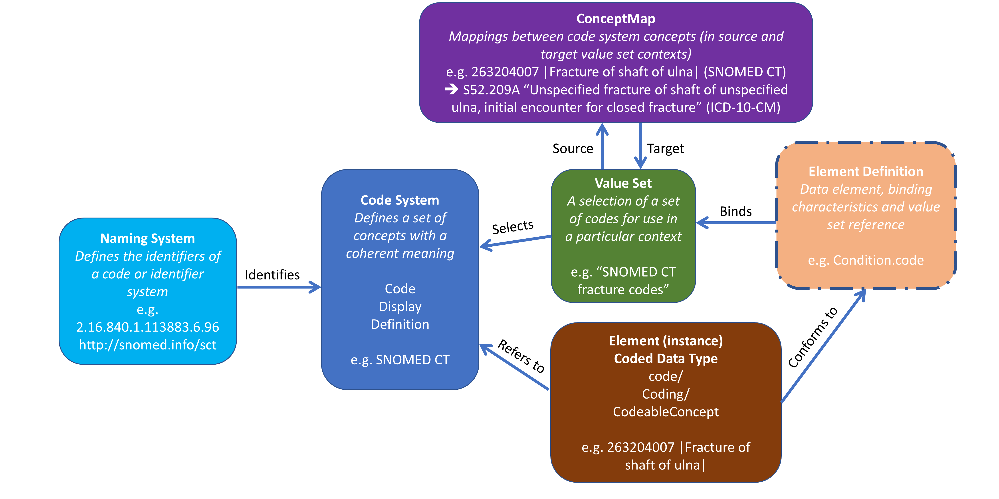
Terminology resource types 7/9
The CodeSystem, ValueSet and ConceptMap relationships

Slide 30
Terminology resource types 8/9
The NamingSystem resource type
is used to identify the existence of a code system or identifier system
has data elements to represent various items of information:
human-readable title and machine-processible name
description and purpose
metadata e.g., identifiers, version, status, publication date
Multiple unique identifiers of the code system or identifier system along with identifier metadata values such as:
type e.g., Object ID (OID), URI, etc.
preferred i.e., whether the identifier value is preferred
comment
period i.e., when the identifier is valid.

Slide 31
Terminology resource types 9/9
The TerminologyCapabilities resource type
is used to document a set of capabilities (behaviors) of a FHIR Terminology Server that may be:
used as a statement of an operational server’s functionality; or
a statement of a required (or desired) server implementation.
is similar to the CapabilityStatement resource but has specific data elements relevant to FHIR Terminology Service server and client implementations
has data elements to represent
software name
code systems supported for terminology service operations
information about the server’s implementation of various terminology service operations
is a draft resource in FHIR R4B and an approved resource in FHIR R5.

Slide 32
Terminology Operations

Slide 33
Terminology operations 1/9
Terminology operations
are part of the Terminology module and based on the FHIR operations framework from the Exchange module: http://hl7.org/fhir/R4B/operations.html
are defined in terms of endpoint URLs, input and output parameters, and client and server behaviors.
include the following operations categorized by terminology resource type
Resource type | Terminology operations summary
CodeSystem | Concept Look Up and Decomposition ($lookup) Code System Based Validation ($validate-code) Subsumption Testing ($subsumes) Finding codes based on supplied properties ($find-matches)
ValueSet | Value Set Expansion ($expand) Value Set based Validation ($validate-code)
ConceptMap | Concept Translation ($translate) Closure Table Maintenance ($closure)

Slide 34
Terminology operations 2/9
The $lookup operation on CodeSystem
Given a concept (as either a code and its code system, a Coding or a CodeableConcept) the operation returns additional details about the concept, including definition, status, designations, and properties.
Usually used to determine whether a concept exists in a code system or to obtain the corresponding concept’s properties and designations
Input parameters | Output parameters
code system version coding date display language property | name version display designation designation.language designation.use designation.value property | property.code property.value property.description property.subproperty property.subproperty.code property.subproperty.code.value property.subproperty.code.description

Slide 35
Terminology operations 3/9
The $validate-code operation on CodeSystem
Validates that a coded value is in the code system.
This is a key mechanism for validating coded data
Input parameters | Output parameters
url codeSystem code version display coding codeableConcept Date abstract displayLanguage | result message display

Slide 36
Terminology operations 4/9
The $subsumes operation on CodeSystem
Tests the subsumption relationship between two concepts (represented as a code or Coding) given the semantics of subsumption in the underlying code system.
May be used for analytics e.g., to find all patients with all forms of a specific condition
Input parameters | Output parameter
codeA codeB system version codingA codingB | outcome

Slide 37
Terminology operations 5/9
The $find-matches operation on CodeSystem
Given a set of properties (and text), return one or more possible matching concepts.
May be used to find a concept which satisfies specific properties in a code system
The $find-matches operation is still preliminary and can be expected to change.
Input parameters | Output parameters
system version property property.code property.value property.subproperty property.subproperty.code property.subproperty.value exact compositional | match match.code match.unmatched match.unmatched.code match.unmatched.value match.unmatched.property match.unmatched.property.code match.unmatched.property.value match.comment

Slide 38
Terminology operations 6/9
The $expand operation on ValueSet
The definition of a value set and its underpinning code system(s) are used to create a value set expansion.
Often used to populate user interface widgets e.g., pull-down menus
Input parameters |  |  | Output parameter
url valueSet valueSetVersion context contextDirection Filter date offset | count includeDesignations designation includeDefinition activeOnly excludeNested excludeNotForUI excludePostCoordinated | displayLanguage exclude-system system-version check-system-version force-system-version | return

Slide 39
Terminology operations 7/9
The $validate-code operation on ValueSet
Validate that a coded value is in the set of codes allowed by a value set.
May be used to confirm that a code is appropriate for a data element bound the particular value set.
Input parameters |  | Output parameters
url context valueSet valueSetVersion code system systemVersion | display coding codeableConcept date abstract displayLanguage | result message display

Slide 40
Terminology operations 8/9
The $translate operation on ConceptMap
Translate a concept from one value set to another, based on the value set and concept map resources, and/or additional knowledge available to the server.
Used whenever a code for an alternative (the target) code system is required e.g., to include multiple concepts in a CodeableConcept value for interoperability.
NOTE: $translate has undergone significant changes in the R5 ballot.
Input parameters |  | Output parameters
url ConceptMap conceptMapVersion code system version source coding | codeableConcept target targetsystem dependency dependency.element dependency.concept reverse | result message match match.equivalence match.concept match.product match.product.element | match.product.concept match.source

Slide 41
Terminology operations 9/9
The $closure operation on ConceptMap
The $closure operation is an advanced operation which provides support for ongoing maintenance of a client-side transitive closure table based on server-side terminological logic.
Input parameters |  | Output parameters
name concept version |  | return

Slide 42
Terminology Documentation

Slide 43
Terminology documentation 1/8
Terminology documentation in the Terminology module
specifies how terminologies are used in the FHIR specification
describes using codes in resources
also includes the following content
HL7 code systems defined and referenced in FHIR
External code systems referenced in FHIR
Value sets defined in FHIR
FHIR defined mappings between related value set concepts
Known identifier systems
NOTE: Known identifier systems were removed in FHIR R5 and are now published in HL7 Terminology.

Slide 44
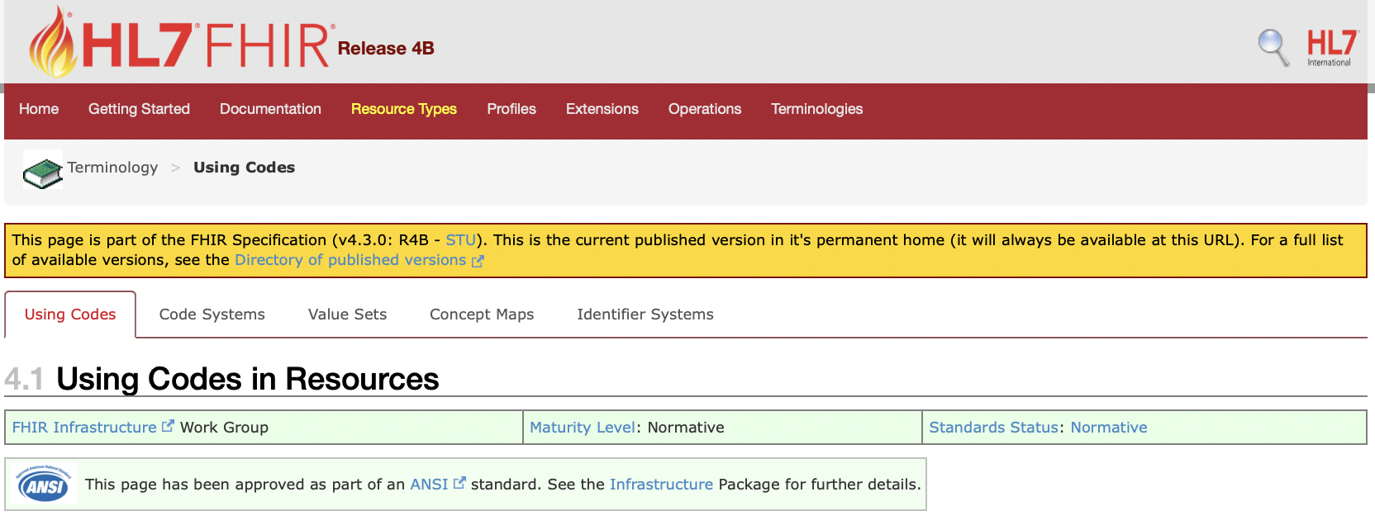
Terminology documentation 2/8
Using codes in resources
Detailed information regarding the use of terminology in FHIR
Addresses
Codes and concepts in FHIR
Code systems and value sets in FHIR
Choosing a code system
Complex code systems
Controlling the use of coded values

Slide 45
Terminology documentation 3/8
Codes and concepts in FHIR
The FHIR framework for using coded values is based on the fundamental framework defined in section 5 of the HL7 V3 Core Principles document, including the separation between code systems and value sets.
In FHIR, coded values are always treated as a pair composed of "system" (code system identifier) and "code", where the system is a URI (ideally a URL) that identifies the code system that defines the codes.
System values are always case sensitive. Different code systems make their own rules as to whether the codes they define are case sensitive or not.
All the codes defined by FHIR itself are case sensitive and SHALL be used in the provided case (usually, but not always, lowercase).

Slide 46
Terminology documentation 4/8
Codes and concepts in FHIR
The general pattern for representing coded elements is using the following four elements:
Element | Description
system | A URI that identifies the system
version | Identifies the version of the system
code | A string pattern that identifies a concept as defined by the code system
display | A description of the concept as defined by the code system

Slide 47
Terminology documentation 5/8
Code systems and value sets in FHIR
IMPORTANT DISTINCTION
CodeSystem resources define concepts and give them meaning through formal definitions, and assign codes that represent the concepts
ValueSet resources specify a set of codes defined by code systems that can be used in a specific context.
This separates
the definition of a concept (in the code system) from
the use of the concept (in the value set)

Slide 48
Terminology documentation 6/8
Controlling the use of coded values
Valid codes for coded values are controlled through a mechanism referred to as binding.
A value set is said to be bound to a data element if the specification defines that data element with a binding to that value set.
Bindings are described through the following properties:
name — a descriptive name for the binding
strength — how the binding should be understood
reference — the URI of the value set being bound
description — a text description of the use of the codes.
In FHIR bindings are specified using the ElementDefinition.binding data element
A
B
C

Slide 49
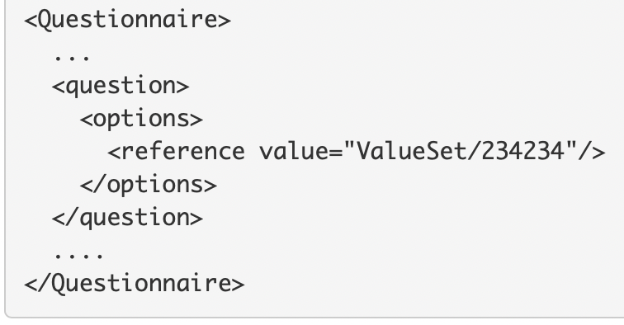
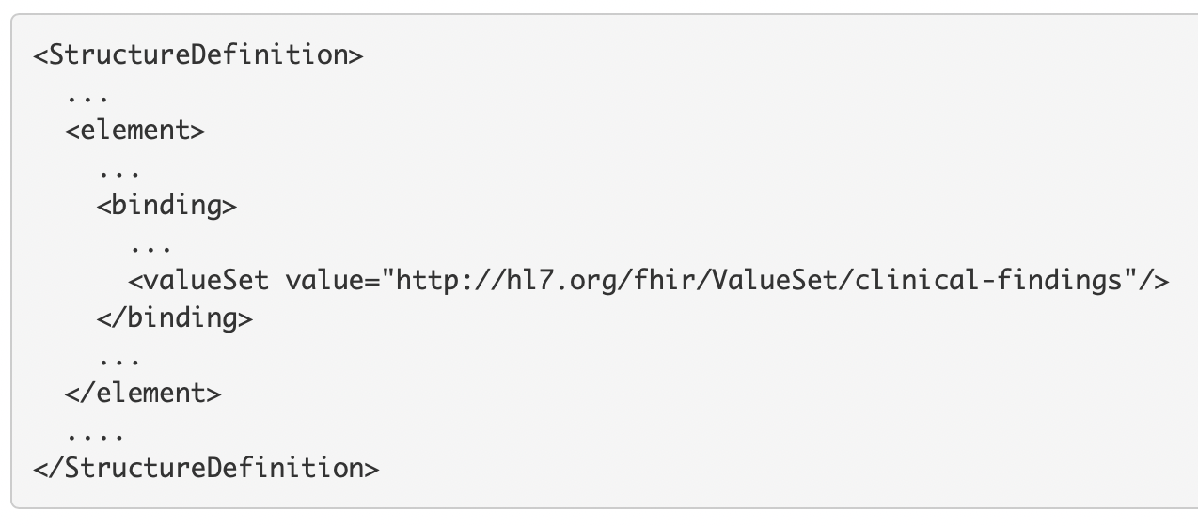
Terminology documentation 7/8
Controlling the use of coded values — Value set references
The are two ways to reference value sets
Direct reference — this uses a FHIR Reference data type to refer to a ValueSet available from a URL on a FHIR Server accessible via the FHIR RESTful API
Logical value set references — this uses a FHIR uri data type where an absolute URI which matches the ValueSet.url value of the value set itself is provided.
Logical value set references may also be version specific e.g.
http://hl7.org/fhir/ValueSet/clinical-findings|0.8

Slide 50
Terminology documentation 8/8
Controlling the use of coded values — Binding strength
When a data element is bound to a value set, the binding strength asserts how closely the value set should be followed to remain conformant
FHIR supports the following binding strengths from most to least restrictive
required — this element SHALL have a value from the specified value set
extensible — this element SHALL have a value from the specified value set if any of the codes within the value set can apply to the concept being communicated. If the value set does not cover the concept (based on human review), alternative concepts may be included instead.
preferred — the element is encouraged to have a value from the value set for interoperability purposes but are not required to do so to be considered conformant.
example — the element is not expected or even encouraged to have a value from the specified value set. The value set merely provides examples of the types of concepts intended to be included.
A
B
C

Slide 51
The FHIR Terminology Service

Slide 52
The FHIR Terminology Service 1/3
Overview
The FHIR specification includes support for the provision of a terminology service — http://hl7.org/fhir/R4B/terminology-service.html
At a high level, the FHIR Terminology Service is described as a service that allows healthcare applications to meaningfully use codes, value sets and concept maps without requiring expertise in the underlying code systems and their terminological principles.
The FHIR Terminology Service is defined as a FHIR server which is required to support a minimum set of functionality including support for a minimum set of terminology resource types, the RESTful API, terminology operations.
Effectively, the complexity of terminologies can then be delegated to a terminology service which makes it easy for applications to access and use the terminologies through an Application Programming Interface (API)

Slide 53
The FHIR Terminology Service 2/3
The FHIR Terminology Service — required functionality.
The following are the minimum requirements for a FHIR Terminology Service
All the standard requirements for a FHIR Server e.g., the Capabilities interaction
Terminology resources
CodeSystem, ValueSet and ConceptMap
RESTful API
Search for CodeSystem, ValueSet and ConceptMap
Operations
$expand, $lookup, $validate-code (Value Set), $subsumes, $translate, $closure
Batch interaction for $translate and $validate-code (Value Set)
NOTE: The minimum requirements for a FHIR Terminology Service has been significantly updated in FHIR R5.

Slide 54
The FHIR Terminology Service 3/3
The FHIR Terminology Service — usage scenarios.
Usage scenario | FHIR Terminology Service solution
Obtain a list of codes to populate a user interface widget e.g., a dropdown list. | Invoke the $expand operation with the value set (which contains the codes) as the input parameter
Obtain a list of codes based on what the user has typed in a user interface text box | Invoke the $expand operation with the value set (which contains the codes) and the text the user has entered as the input parameters
Determine if a received code is valid. | Invoke the $validate-code operation with the received code as the input parameter
Obtain the display names (descriptions) for a code to display them in a user interface ? | Invoke the $lookup operation with the received code as the input parameter
Obtain a translation of a concept in one code system to a concept in another code system. | Invoke the $translate operation with the source code and a concept map as the input parameters

Slide 55
Additional TOPICS

Slide 56
Additional topics
Introduction to HL7 Terminology — http://terminology.hl7.org (THO)
HL7 Terminology
is an HL7 service provided as a publicly accessible web site.
represents a new way for HL7 to publish its terminology artefacts, which were previously contained within various standards and guides in the different HL7 product families.
is managed by the HL7 Terminology Services Management Group (TSMG)

Slide 57
Additional topics
Introduction to the HL7 Unified Terminology Governance (UTG)
UTG is
the HL7 process for governance and maintenance of the vocabulary published in HL7 Terminology.
employs a community-wide, consensus-based, continuous process for updates to the terminology.
relies upon JIRA to manage change requests and employs voting by terminology experts from across HL7.
managed by the TSMG.

Slide 58
Additional topics
Terminology groups in HL7 — PARTICIPATION WELCOME!
Terminology Infrastructure WG (TI WG)
Responsible for all terminology methodology and standards development including curating the Terminology module in the FHIR specification.
Also responsible for the Gender Harmony project
Terminology Services Management Group (TSMG)
Responsible for developing and setting policies related to terminology.
Currently has three subcommittees:
HL7 Terminology and UTG
HL7 Terminology Authority (HTA)
Outreach and education

Slide 59
Thank you!
Reuben Daniels, FAIDH CHIA
HL7 Working Group Meeting Plus
New Orleans, Louisiana, USA

